Slide 1
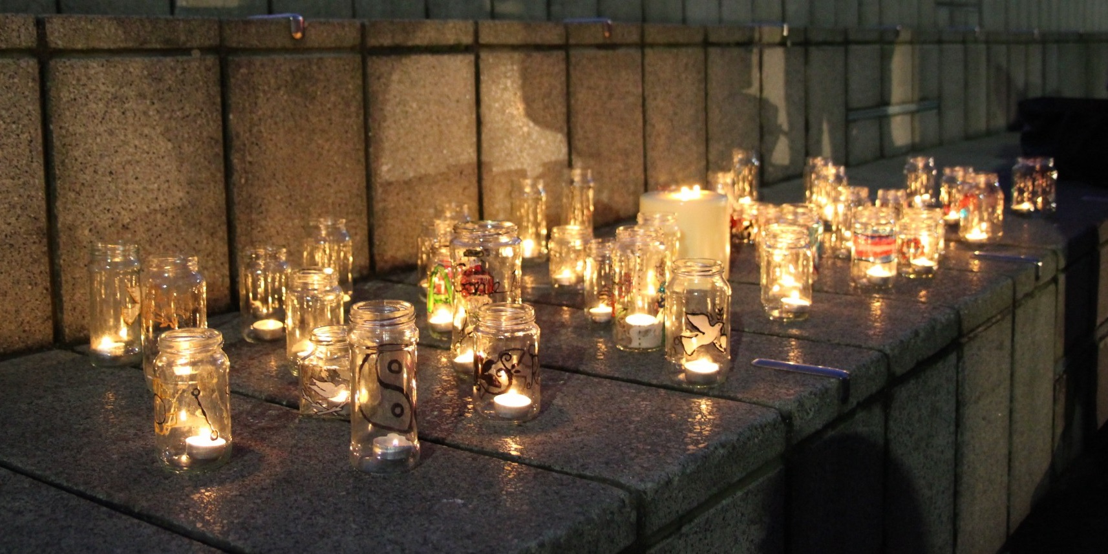
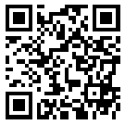
Trans Lives Matter: Remembering Our Dead Trans Day of Remembrance 2023
https://tdor.translivesmatter.info/

Slide 2
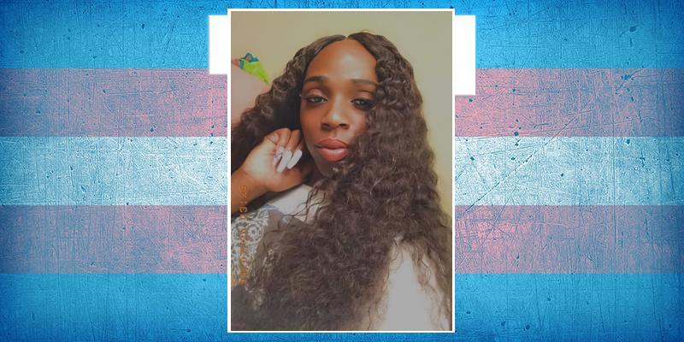
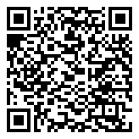
Tiffany Banks Age 25 Miami, Florida (USA) shot. 1 Oct 2022

Slide 3

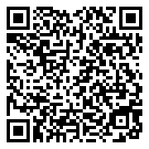
Karla Santos Pabellón de Arteaga, Aguascalientes (Mexico) run over. 3 Oct 2022

Slide 4
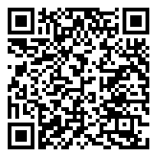
Tante Butet Age 50 Bekasi, Jawab Barat (Indonesia) beaten. 3 Oct 2022

Slide 5
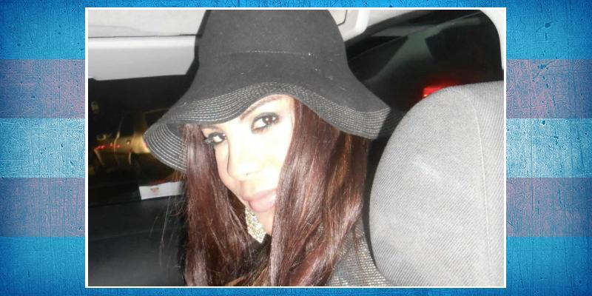
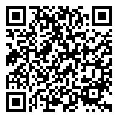
Naomi Cabral Age 47 Ardea, Lazio (Italy) strangled and suffocated. 5 Oct 2022

Slide 6
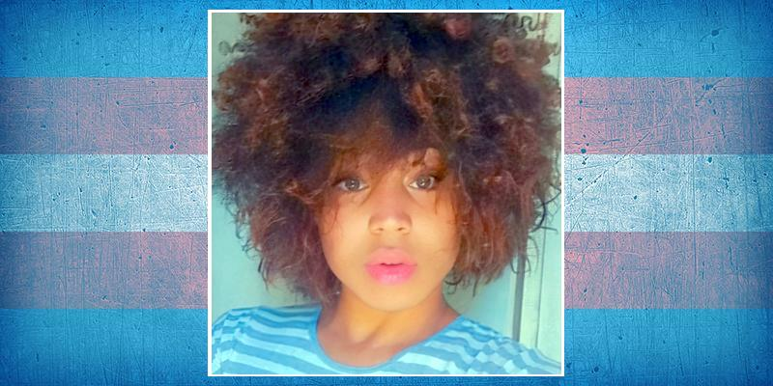
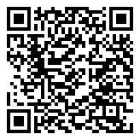
Alexia Silva de Santana Age 19 Salvador, Bahia (Brazil) shot. 6 Oct 2022

Slide 7
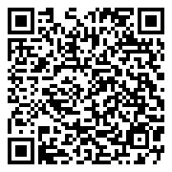
Bianca Carvalho Gonçalves Age 22 Primavera do Leste, Mato Grosso (Brazil) shot. 6 Oct 2022

Slide 8
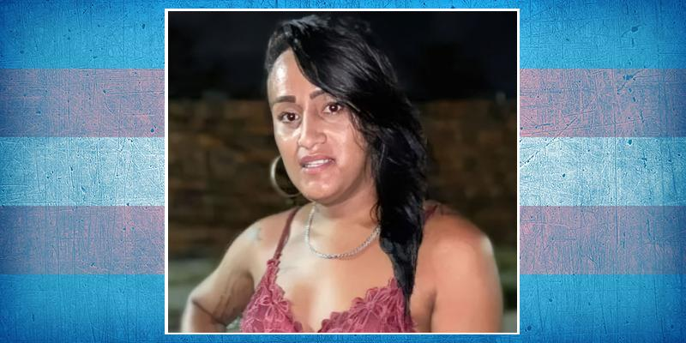
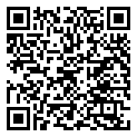
Natasha Age 27 Forquilha, Ceará (Brazil) shot. 6 Oct 2022

Slide 9
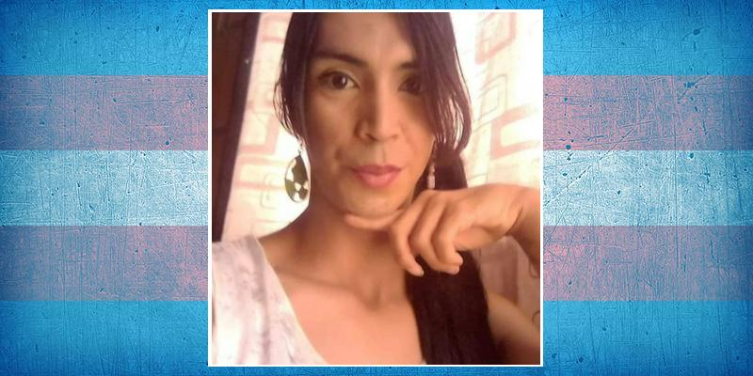
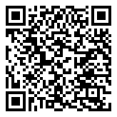
Mayté Mejía Age 28 Calaraca, Quindio (Colombia) stabbed. 9 Oct 2022

Slide 10
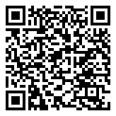
Joyeey Akter Nagini Age 20 Chittagong (Bangladesh) strangled. 9 Oct 2022

Slide 11
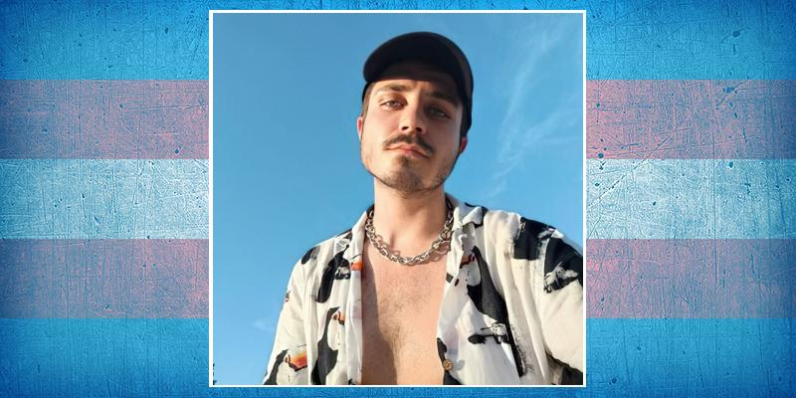
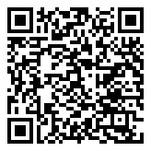
Juraj Vankulic Age 27 Bratislava (Slovakia) shot. 12 Oct 2022

Slide 12

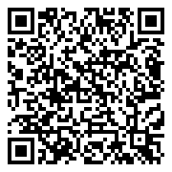
Ester da Silva Age 15 Natal, Rio Grande do Norte (Brazil) stabbed and decapitated. 14 Oct 2022

Slide 13
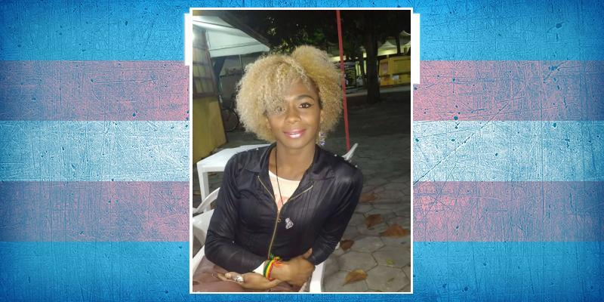
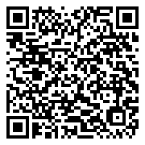
Daniely Medeiros Gonçalves Age 26 Cabo Frio, Rio de Janeiro (Brazil) run over. 14 Oct 2022

Slide 14
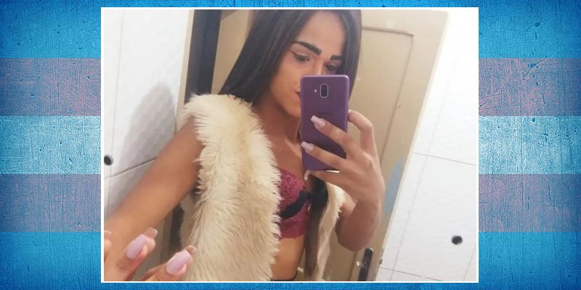
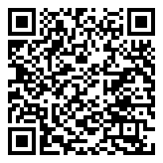
Bárbara Rafaela Age 23 Jaboticabal, São Paulo (Brazil) shot. 15 Oct 2022

Slide 15
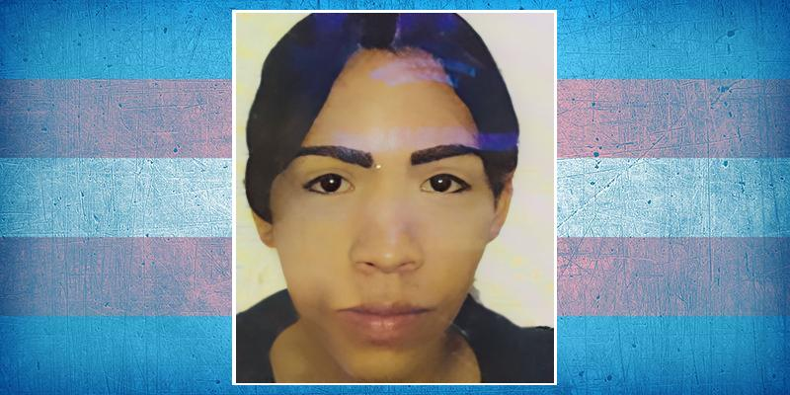
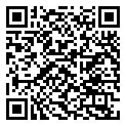
J. C. Gómez Age 18 Cartago, Valle del Cauca (Colombia) suicide. 16 Oct 2022

Slide 16
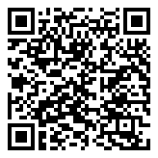
Name Unknown Age 26-30 Cancun, Quintana Roo (Mexico) beaten. 17 Oct 2022

Slide 17
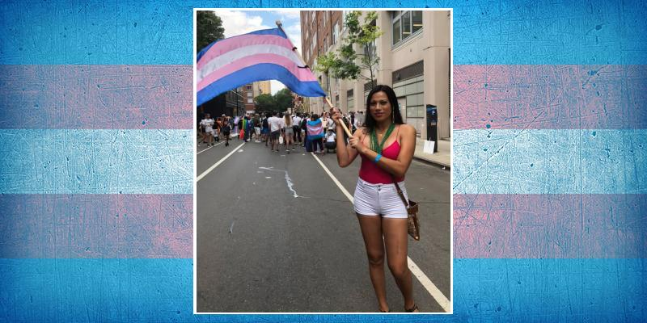
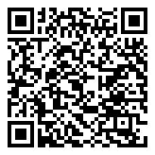
Melissa Núñez Age 42 Morocelí, El Paraíso (Honduras) shot. 18 Oct 2022

Slide 18
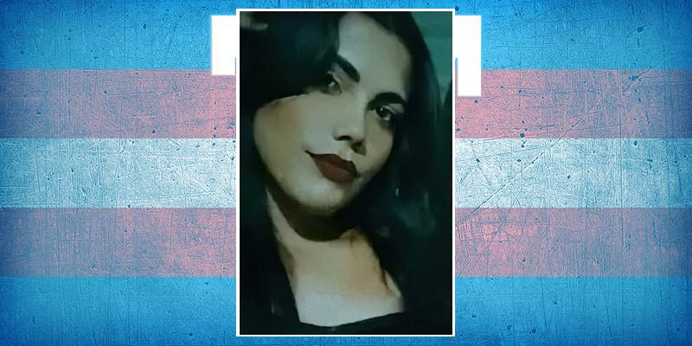
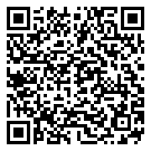
Daniella Santos ("Danny") Age 20 Senhor do Bonfim, Bahia (Brazil) shot. 18 Oct 2022

Slide 19
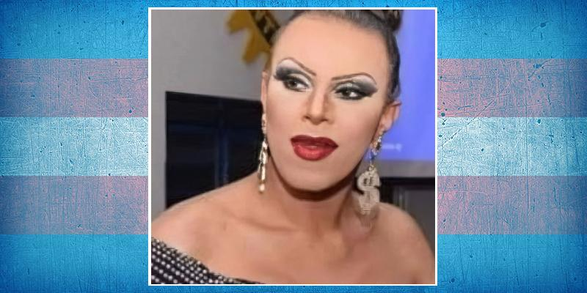
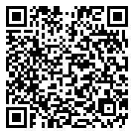
Victória Jakson Age 37 Presidente Epitácio, São Paulo (Brazil) stabbed. 18 Oct 2022

Slide 20

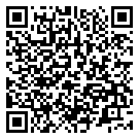
Jessica Zoe ("Yulia") Ecatepec, Estado de México (Mexico) murdered. 20 Oct 2022

Slide 21
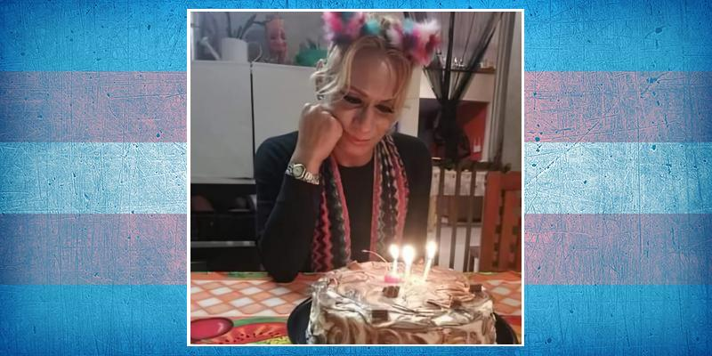
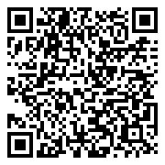
Britney Hernández Vargas Xalapa, Veracruz (Mexico) beaten. 20 Oct 2022

Slide 22
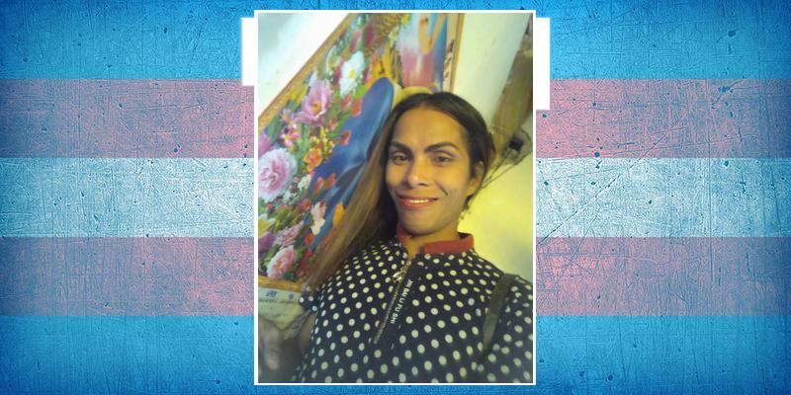
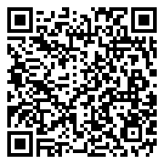
Samantha Nicole Quirino Age 32 Cuyo, Palawan (Philippines) hanged. 22 Oct 2022

Slide 23
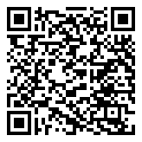
Chiara Colombini Age 19 Naples, Campania (Italy) suicide. 24 Oct 2022

Slide 24
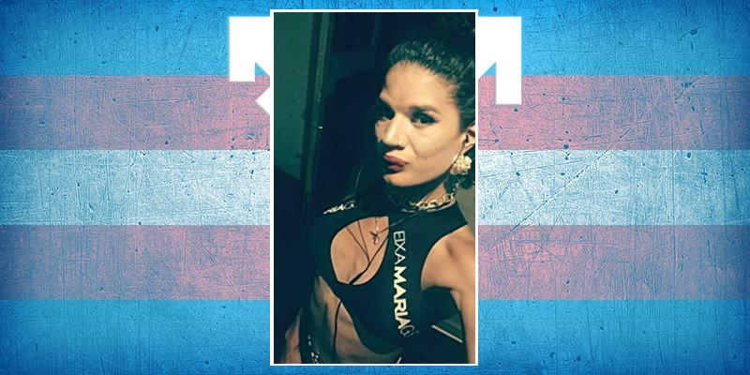
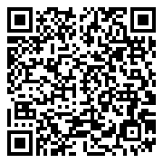
Evelyn Sampaio de Moraes Age 24 Sumaré, São Paulo (Brazil) strangled. 25 Oct 2022

Slide 25
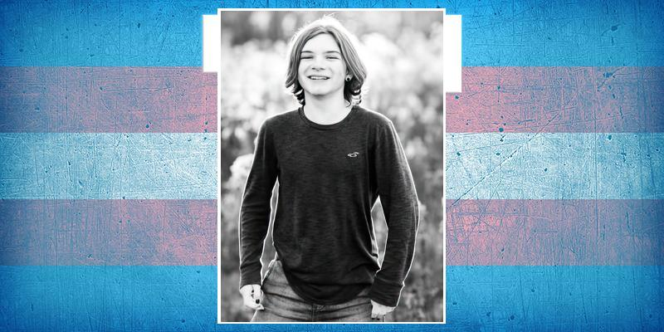
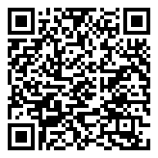
Brayden Snyder Age 15 Ephrata, Pennsylvania (USA) suicide. 25 Oct 2022

Slide 26

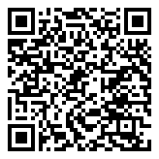
Luciana Desiré Vaca Age 34 La Paz (Bolivia) suicide. 26 Oct 2022

Slide 27
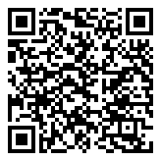
Name Unknown Ciudad Juarez, Chihuahua (Mexico) shot. 28 Oct 2022

Slide 28
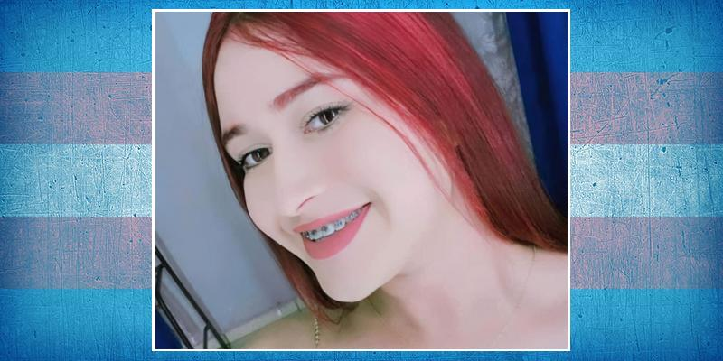
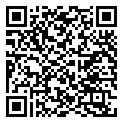
Liz Hernández Age 18 Padilla, Tamaulipas (Mexico) murdered. 1 Nov 2022

Slide 29
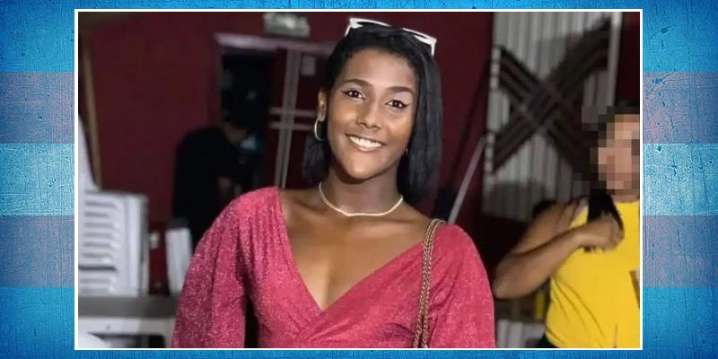
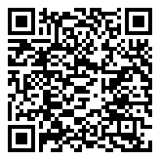
Kauana Vasconcelos Age 16 Ibicaraí, Bahia (Brazil) stabbed. 3 Nov 2022

Slide 30
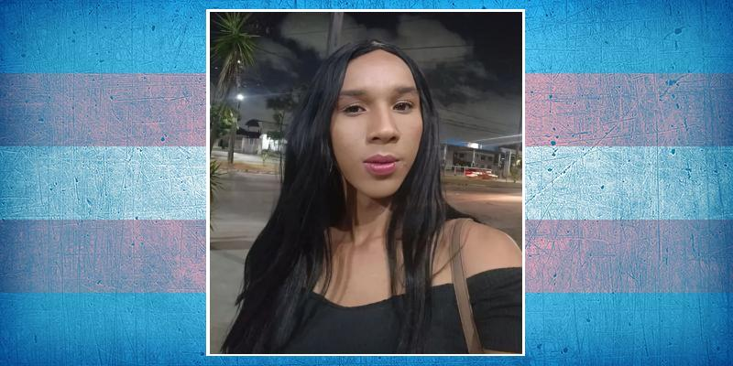
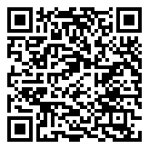
Jessica Silva ("Jessy") Fortaleza, Ceará (Brazil) stabbed. 3 Nov 2022

Slide 31


Renata Nicole Duarte Reyes Age 29 Cuautla, Morelos (Mexico) shot. 4 Nov 2022

Slide 32


Kimberly Fernanda Mendoza Sevilha Cuautla, Morelos (Mexico) shot. 4 Nov 2022

Slide 33


Carla Pereira Age 41-50 Teresina, Piauí (Brazil) beaten. 5 Nov 2022

Slide 34


Martha Torres Lomelí Age 58 Irapuato, Guanajuato (Mexico) murdered. 5 Nov 2022

Slide 35


Maël Eden Paufert Age 30 Strasbourg, Bas-Rhin (France) suicide. 5 Nov 2022

Slide 36


Myles Fitzpatrick Age 17 Manville, New Jersey (USA) suicide. 7 Nov 2022

Slide 37

Keyti Sayuri Rodríguez Vásquez Santiago (Chile) stabbed. 8 Nov 2022

Slide 38

Nazma Akhtar Age 30 Chittagong (Bangladesh) shot. 9 Nov 2022

Slide 39


Chepina Arteaga Morante Age 22 Chone, Manabí (Ecuador) shot. 10 Nov 2022

Slide 40


Jerry Rodrigues Age 45 Coreaú, Ceará (Brazil) shot. 10 Nov 2022

Slide 41

Name Unknown Age 19 Caucaia, Ceará (Brazil) shot. 11 Nov 2022

Slide 42


Karen Sánchez Alvarez Age 21 Toluca, Estado de México (Mexico) shot. 12 Nov 2022

Slide 43


Maiken/Dani Cooper Age 25-30 Vancouver, British Colombia (Canada) shot. 12 Nov 2022

Slide 44

Name Unknown Age 31-40 Tijuana, Baja California (Mexico) shot. 12 Nov 2022

Slide 45


Emma Borhanian Age 31 Vallejo, California (USA) shot. 13 Nov 2022

Slide 46

J. Royos Age 15 Bogo City, Cebu (Philippines) stabbed. 13 Nov 2022

Slide 47


Adalyn Anderson Age 24 Oklahoma City (USA) suicide. 15 Nov 2022

Slide 48

Name Unknown Tamazula de Gordiano, Jalisco (Mexico) 15 Nov 2022

Slide 49


Mariela Jorgelina Romero Age 58 Berisso, Buenos Aires (Argentina) possible suicide. 17 Nov 2022

Slide 50


Marta Castaña Age 65 Rome, Lazio (Italy) stabbed. 17 Nov 2022

Slide 51


Bruninha da Silva Age 24 Belo Jardim, Pernambuco (Brazil) stoned. 18 Nov 2022

Slide 52


Finn Hall Age 16 Huddersfield, West Yorkshire (United Kingdom) suicide. 18 Nov 2022

Slide 53


Daniel Davis Aston Age 28 Colorado Springs (USA) shot. 19 Nov 2022

Slide 54


Kelly Loving Age 40 Colorado Springs (USA) shot. 19 Nov 2022

Slide 55


Rihanna Rodrigues dos Santos Age 37 Campo Grande, Matto Grosso do Sul (Brazil) beaten. 20 Nov 2022

Slide 56


Brenda Age 27 San Martin, Buenos Aires (Argentina) burned. 22 Nov 2022

Slide 57


Matty Sheldrick Age 29 Brighton, East Sussex (United Kingdom) suicide. 22 Nov 2022

Slide 58

O. E. B. Pineda Age 24 Valencia, Carabobo (Venezuela) shot. 23 Nov 2022

Slide 59


Bekett Noble Age 34 Ancaster, Ontario (Canada) suicide. 23 Nov 2022

Slide 60


Olvin Osório Doroteo Oluta, Veracruz (Mexico) stabbed. 24 Nov 2022

Slide 61


Diamond Jackson-McDonald Age 27 Philadelphia, Pennsylvania (USA) shot. 24 Nov 2022

Slide 62

Ángela María Bernal Ospina Age 39 Mariquita, Tolima (Colombia) murdered. 25 Nov 2022

Slide 63


Ana Paula dos Santos Age 32 Jaciara, Mato Grosso (Brazil) beaten and stabbed. 27 Nov 2022

Slide 64

Adriana Santos Messias, Alagoas (Brazil) burned. 28 Nov 2022

Slide 65

Name Unknown Guadalajara, Jalisco (Mexico) murdered. 29 Nov 2022

Slide 66


Day Rodas Age 27 Malibu, California (USA) overdose. 1 Dec 2022

Slide 67

Gabriela Age 30-40 Bogotá, Distrito Capital (Colombia) stabbed. 4 Dec 2022

Slide 68


Jossi Córdova Macas Arenillas, El Oro (Ecuador) shot. 4 Dec 2022

Slide 69


Morgan Dee Age 32 Fort Wayne, Indiana (USA) suicide. 4 Dec 2022

Slide 70

Name Unknown Ciudad de Mexico (Mexico) murdered. 8 Dec 2022

Slide 71


Endriely Prestes Aguiar Age 30 Canaã dos Carajás, Pará (Brazil) shot. 9 Dec 2022

Slide 72


Jaqueline Fyoruti Age 49 Três Lagoas, Mato Grosso do Sul (Brazil) stabbed. 9 Dec 2022

Slide 73


Destiny Howard Age 23 Macon, Georgia (USA) shot. 9 Dec 2022

Slide 74


Claudia Díaz Pérez Age 73 Cartagena, San Antonio (Chile) suffocated. 11 Dec 2022

Slide 75


Ximena Madrid Flores Age 28 Teotihuacán, Estado de México (Mexico) 14 Dec 2022

Slide 76


Mar’Quis ‘MJ’ Jackson Age 33 Philadelphia, Pennsylvania (USA) beaten. 14 Dec 2022

Slide 77

W. de Oliveira Rodrigues Age 22 Campo Grande, Mato Grosso Do Sul (Brazil) stabbed. 15 Dec 2022

Slide 78

Name Unknown Age 24 Tijuana, Baja California (Mexico) shot. 16 Dec 2022

Slide 79


Ariana Diaz Chávez Age 42 La Plata, Buenos Aires (Argentina) strangled. 16 Dec 2022

Slide 80


Henry Berg-Brousseau Age 24 Louisville, Kentucky (USA) suicide. 16 Dec 2022

Slide 81


Caelee Love-Light Age 27 Phoenix, Arizona (USA) shot. 17 Dec 2022

Slide 82


Lully Pimentel Age 19 Vitória de Santo Antão, Pernambuco (Brazil) shot. 17 Dec 2022

Slide 83


Kamilla Nogueira/Camila de Souza Age 29 Sarandi, Paraná (Brazil) beaten. 18 Dec 2022

Slide 84


Jady Age 27 Guarapuava, Paraná (Brazil) beaten. 19 Dec 2022

Slide 85


Levi Martin Age 17 Lakeville, Massachusetts (USA) suicide. 22 Dec 2022

Slide 86

Aaiyza Bahawalpur, Punjab (Pakistan) shot. 23 Dec 2022

Slide 87


Brauny Alcántara Age 27 Santiago (Dominican Republic) beaten and drowned. 23 Dec 2022

Slide 88


Sheyla Tehuantepec, Oaxaca (Mexico) murdered. 23 Dec 2022

Slide 89

Name Unknown Age 40 Bilbao, Biscay (Spain) suffocated. 24 Dec 2022

Slide 90


Patricia Ramírez Age 41 Corrientes (Argentina) run over. 26 Dec 2022

Slide 91


Kauany Bacelar Age 17 Salvador, Bahia (Brazil) shot. 28 Dec 2022

Slide 92


Elaine Englis Age 39 Cebu City (Philippines) stabbed. 31 Dec 2022

Slide 93


Liza Kistauri Age 26 Antwerp (Belgium) 2 Jan 2023

Slide 94

Name Unknown Bundibugyo (Uganda) beaten. 3 Jan 2023

Slide 95

Name Unknown Age 18 Santo André, São Paulo (Brazil) hanged. 4 Jan 2023

Slide 96


Ecem Seçkin Age 22 İzmir (Turkey) stabbed. 4 Jan 2023

Slide 97


Tailla Ariany Santos Age 31 Rio de Janeiro (Brazil) killed and dismembered. 4 Jan 2023

Slide 98


Gwen Gatewood Age 22 Michigan (USA) suicide. 4 Jan 2023

Slide 99

Name Unknown Age 25 Ubá, Minas Gerais (Brazil) shot. 4 Jan 2023

Slide 100


T. L. de Sousa Age 24 João Pessoa, Paraíba (Brazil) shot. 6 Jan 2023

Slide 101


Jasmine "Star" Mack Age 36 Washington, D.C. (USA) stabbed. 7 Jan 2023

Slide 102


Sebastiana Pereira de Souza ("Tiana") Colinas, Maranhão (Brazil) beaten. 7 Jan 2023

Slide 103


Samantha Fuentes Coatepeque, Quetzaltenango (Guatemala) beaten. 8 Jan 2023

Slide 104


Rayca Pereira de Jesus Age 20 Barreiras, Bahia (Brazil) shot. 8 Jan 2023

Slide 105

K. B. Misador Age 25 Ballesteros, Cagayan (Philippines) stabbed. 8 Jan 2023

Slide 106

Victor Age 19 Guaiúba, Ceará (Brazil) shot. 9 Jan 2023

Slide 107


Gabriel Godoy Age 29 Barra Bonita, São Paulo (Brazil) suicide. 10 Jan 2023

Slide 108

Minal Age 22 New Delhi (India) stabbed. 10 Jan 2023

Slide 109


KC Johnson Age 27 Wilmington, North Carolina (USA) beaten. 13 Jan 2023

Slide 110

Fran Jungers Neto Age 35 Londrina, Paraná (Brazil) stabbed. 13 Jan 2023

Slide 111


Sofía Agustina Bravo Age 26 La Carlota, Córdoba (Argentina) murdered. 14 Jan 2023

Slide 112

Pinki New Delhi (India) stabbed. 15 Jan 2023

Slide 113


Stheffany Ashley da Silva Neves ("Eyshila") Age 25 Pontes e Lacerda, Mato Grosso (Brazil) shot. 16 Jan 2023

Slide 114


Aurora Claire Stark Age 42 Halifax, Nova Scotia (Canada) suicide. 16 Jan 2023

Slide 115


Denisse Cabaly Age 29 Veracruz (Mexico) beaten. 17 Jan 2023

Slide 116


María José Torres Astros Age 33 Villavicencio, Meta (Colombia) stabbed. 17 Jan 2023

Slide 117


La Gata Age 68 Medellín, Antioquia (Colombia) stabbed. 18 Jan 2023

Slide 118


Manuel Teran ("Tortugita") Age 26 Atlanta, Georgia (USA) shot. 18 Jan 2023

Slide 119


Olivia Snow Age 47 New York City (USA) 19 Jan 2023

Slide 120


Paris Beristain Vergara Valério Age 31 Acayucan, Veracruz (Mexico) shot. 20 Jan 2023

Slide 121


Dani Millán Ciudad de Mexico (Mexico) beaten. 20 Jan 2023

Slide 122

Praneetha Age 29 Rajahmundry, Andhra Pradesh (India) suicide. 21 Jan 2023

Slide 123


Erika Quintana Ávalos Age 22 Trujillo, La Libertad (Peru) burned. 21 Jan 2023

Slide 124


Maria Jose Rivera Rivera Age 20-25 Houston, Texas (USA) shot. 21 Jan 2023

Slide 125

Name Unknown Karachi, Sindh (Pakistan) 22 Jan 2023

Slide 126


Unique Banks Age 20 Chicago, Illinois (USA) shot. 23 Jan 2023

Slide 127


Ale Castillo Limache Camaná, Arequipa (Peru) murdered. 24 Jan 2023

Slide 128


Ivory Nicole Smith Age 27 San Francisco, California (USA) 24 Jan 2023

Slide 129


Vera Lúcia Lopes Siqueira ("Julia Cristina") Age 27-29 Norte de Minas, Minas Gerais (Brazil) shot. 25 Jan 2023

Slide 130


Franchesca Gomez Pedro Juan Caballero, Amambay (Paraguay) stabbed. 26 Jan 2023

Slide 131


Noah O'Brien Age 14 Westmead, New South Wales (Australia) suicide. 26 Jan 2023

Slide 132

Name Unknown Age 50 Buenos Aires (Argentina) possible suicide. 27 Jan 2023

Slide 133


Rafaela Moraes Izaias Age 28 Porto Ferreira, São Paulo (Brazil) stabbed. 28 Jan 2023

Slide 134


Samantha Campana Age 23 Maringá, Paraná (Brazil) stabbed. 29 Jan 2023

Slide 135


Greyci Kelly Age 43 Jales, São Paulo (Brazil) murdered. 30 Jan 2023

Slide 136


Paris Alexsandry Age 37-39 Juchitán de Zaragoza, Oaxaca (Mexico) shot. 2 Feb 2023

Slide 137


Nety Cosme Age 41 Pancas, Espirito Santo (Brazil) stabbed. 3 Feb 2023

Slide 138


Imanitwitaho Zachee Age 26 Louisville, Kentucky (USA) shot. 3 Feb 2023

Slide 139

Z. A. Rawalpindi, Punjab (Pakistan) hanged. 5 Feb 2023

Slide 140

Sandra Age 64 Barcelona, Catalonia (Spain) stabbed. 7 Feb 2023

Slide 141

Name Unknown Age 20-25 Chiclayo (Peru) shot. 8 Feb 2023

Slide 142

Lelê Age 19 Fortaleza, Ceará (Brazil) murdered. 8 Feb 2023

Slide 143


Aithana Camila Azul Vargas Caicedo Age 25 Babahoyo, Los Rios (Ecuador) shot. 10 Feb 2023

Slide 144


Aylla Sofia Belém, Pará (Brazil) stabbed. 11 Feb 2023

Slide 145


Veronica Manganese Age 23 Ponsacco, Pisa (Italy) suicide. 11 Feb 2023

Slide 146


Brianna Ghey Age 16 Warrington, Cheshire (United Kingdom) stabbed. 11 Feb 2023

Slide 147


La Pájara Age 22 Barranquilla, Atlántico (Colombia) shot and stabbed. 11 Feb 2023

Slide 148

Luara de Souza Machado Age 27 Fortaleza, Ceará (Brazil) stabbed. 11 Feb 2023

Slide 149


Priscila Aguado Hutaco Age 26-30 Chorrillos/San Juan de Miraflores, Lima (Peru) shot. 11 Feb 2023

Slide 150


Sofia Gonçalves de Oliveira Age 23 Patos de Minas, Minas Gerais (Brazil) shot. 12 Feb 2023

Slide 151

Mishi Kohat, Khyber Pakhtunkhwa (Pakistan) shot. 12 Feb 2023

Slide 152

Michelle Jesús P. C. ("Jaki") Age About 40 Mérida, Yucatán (Mexico) murdered. 12 Feb 2023

Slide 153


Agatha Santos Nova Floresta, Paraíba (Brazil) suicide. 13 Feb 2023

Slide 154


Ruby Ferrer Age 30 Carabayllo, Lima (Peru) shot. 14 Feb 2023

Slide 155


Rayane Cássia Bittencourt Nogueira Age 23 Porto Real, Rio de Janeiro (Brazil) beaten and strangled. 15 Feb 2023

Slide 156

Camila Sánchez Age 19-25 Chiclayo, Lambayeque (Peru) tortured. 16 Feb 2023

Slide 157

Name Unknown Age 19 to 25 Lambayeque (Peru) beaten. 16 Feb 2023

Slide 158

Cataleya Amazonas (Peru) murdered. 17 Feb 2023

Slide 159

Mirela Age 27 Fortaleza, Ceará (Brazil) beaten. 18 Feb 2023

Slide 160


Andrea Lopez Age 57 La Rioja (Argentina) run over. 18 Feb 2023

Slide 161


Sabrina Medeiros Age 43 Maria Helena, Paraná (Brazil) beaten. 19 Feb 2023

Slide 162

Mahnoor Mingora, Khyber Pakhtunkhwa (Pakistan) shot. 19 Feb 2023

Slide 163

Katia Age 47 Soledad, Atlántico (Colombia) shot. 19 Feb 2023

Slide 164

Name Unknown Gazipur (Bangladesh) stabbed. 19 Feb 2023

Slide 165

Shakira Age 26 Campina Grande, Paraíba (Brazil) shot. 20 Feb 2023

Slide 166


Iván Guadalupe Lima Fortete Age 12 Sallent, Barcelona (Spain) suicide. 21 Feb 2023

Slide 167

Sana Age 29 Chennai, Tamil Nadu (India) throat cut. 23 Feb 2023

Slide 168


Cashay Henderson Age 31 Milwaukee, Wisconsin (USA) shot. 25 Feb 2023

Slide 169


Shaina Vanessa Pretel Gómez Age 28 Cali, Valle del Cauca (Colombia) shot. 26 Feb 2023

Slide 170


Thalyta Gabriely Alves Sousa Age 20 Anapú, Pará (Brazil) murdered. 27 Feb 2023

Slide 171


Khina Zakharova Age 21 Smallingerland, Friesland (Netherlands) suicide. 27 Feb 2023

Slide 172


Alana da Silva Age 27 Porto Velho, Rondônia (Brazil) suicide. 1 Mar 2023

Slide 173


Lorena Fox Age 27 Luis Eduardo Magalhães, Bahia (Brazil) murdered. 1 Mar 2023

Slide 174


Violeta Navarrete Age 35 Ahome, Sinaloa (Mexico) beaten. 1 Mar 2023

Slide 175


Caitlyn Éowyn Earhart ("Cait") Age 19 St. Louis, Missouri (USA) suicide. 1 Mar 2023

Slide 176


Paris Marchant Dioses Age 35 Machala, El Oro (Ecuador) shot. 3 Mar 2023

Slide 177


W. P. da Silva Souza Porto Velho, Rondônia (Brazil) shot. 3 Mar 2023

Slide 178

Lichi Age 50 New Delhi (India) suffocated. 3 Mar 2023

Slide 179


Negão Age 23 Petrolina, Pernambuco (Brazil) shot. 7 Mar 2023

Slide 180


Juana Mena Hernández Age 23 Masaya (Nicaragua) beaten. 7 Mar 2023

Slide 181


Amanda Rodrigues Ribeiro Age 38 São João da Barra, Rio de Janeiro (Brazil) beaten. 9 Mar 2023

Slide 182

Jordana Cancun, Quintana Roo (Mexico) shot. 10 Mar 2023

Slide 183


Joyce Kelly Maceió, Alagoas (Brazil) stabbed. 10 Mar 2023

Slide 184


Caju Age 36 Camocim, Ceará (Brazil) stabbed. 11 Mar 2023

Slide 185


Eden Knight Age 23 Ryiadh (Saudi Arabia) suicide. 12 Mar 2023

Slide 186

Jenny Tamuín, San Luis Potosí (Mexico) shot. 13 Mar 2023

Slide 187


Renna Rodrigues/Rena de Moura Fortaleza, Ceará (Brazil) stabbed. 13 Mar 2023

Slide 188


Alondra Chacon Avila Age 33 Toluca, Estado de México (Mexico) shot. 16 Mar 2023

Slide 189


Laila Age 27 Jaguarari, Bahia (Brazil) shot. 16 Mar 2023

Slide 190


Keyly Daniela Macías Cortés Age 25 Guayaquil, Guayas (Ecuador) beaten and throat cut. 16 Mar 2023

Slide 191


Alya Age 32 Tapin, South Kalimantan (Indonesia) beaten. 16 Mar 2023

Slide 192

Joseline Tecomán, Colima (Mexico) murdered. 16 Mar 2023

Slide 193

Name Unknown Tecomán, Colima (Mexico) murdered. 16 Mar 2023

Slide 194


Camila La Crespa Age 44 Neiva, Huila (Colombia) stabbed. 17 Mar 2023

Slide 195


Maria Fernanda Hilton Age 32 São Paulo (Brazil) shot. 19 Mar 2023

Slide 196


Michele Souza Vitória de Santo Antão, Pernambuco (Brazil) shot. 19 Mar 2023

Slide 197


Kayleigh Scott Age 25 Denver, Colorado (USA) suicide. 20 Mar 2023

Slide 198

Name Unknown João Pessoa, Paraíba (Brazil) burned. 20 Mar 2023

Slide 199

Mala Age 43 Riau (Indonesia) strangled. 20 Mar 2023

Slide 200


Mateo Briones Alvarado Age 16 Daule, Guayas (Ecuador) shot. 21 Mar 2023

Slide 201


Lucy Salani Age 98 Bologna (Italy) natural causes. 22 Mar 2023

Slide 202


Luna Ramírez Soto Age 29 Bello, Antioquia (Colombia) stabbed. 24 Mar 2023

Slide 203


Tasiyah Woodland ("Siyah") Age 18 Mechanicsville, Maryland (USA) shot. 24 Mar 2023

Slide 204


Victoria Pereira Age 22 Rivera (Uruguay) stabbed. 25 Mar 2023

Slide 205


Rebeka Vendaval Paraupebas, Pará (Brazil) beaten and stoned. 25 Mar 2023

Slide 206


Mónica Jiménez Belmont Age 41 Ciudad de México (Mexico) beaten. 29 Mar 2023

Slide 207


Ketlhyn da Silva Nascimento Age 16 São João Del Rei, Minas Gerais (Brazil) shot. 29 Mar 2023

Slide 208

Kenia Salazar Age 38 Chocaman, Veracruz (Mexico) shot. 29 Mar 2023

Slide 209

Name Unknown Fortaleza, Ceará (Brazil) shot. 30 Mar 2023

Slide 210


Emmily Rodrigues Age 26 Buenos Aires (Argentina) fell. 30 Mar 2023

Slide 211

Name Unknown Colima (Mexico) shot. 31 Mar 2023

Slide 212


Karla Santos Age 44 Itabuna, Bahia (Brazil) burned. 1 Apr 2023

Slide 213


Brigitte Guayaquil, Guayas (Ecuador) stabbed. 2 Apr 2023

Slide 214


Tania Viviana Sandoval Ramírez Trujillo, La Libertad (Peru) stabbed. 5 Apr 2023

Slide 215


Cecibel ("Ceci") Age 31 Buena Fe, Los Rios (Ecuador) stabbed. 7 Apr 2023

Slide 216


Jordana Cortez Esmeraldas (Ecuador) murdered. 9 Apr 2023

Slide 217


Sofia Inés Fernández Age 39 Pilar, Buenos Aires (Argentina) killed in custody. 10 Apr 2023

Slide 218

Name Unknown Age 15 Ho Chi Minh City (Vietnam) suicide. 10 Apr 2023

Slide 219


Ashley Burton Age 37 Atlanta, Georgia (USA) shot. 11 Apr 2023

Slide 220

Name Unknown Age 40 Libertad, San José (Uruguay) died in custody. 11 Apr 2023

Slide 221


Eduarda Emanuelly São Paulo (Brazil) stabbed. 11 Apr 2023

Slide 222


Ariel Mendoza Age 36 Managua (Nicaragua) tortured and burned. 11 Apr 2023

Slide 223

Name Unknown Diorama, Goiás (Brazil) shot. 13 Apr 2023

Slide 224


Moe Moore Age 18 Louisville, Kentucky (USA) possible suicide. 14 Apr 2023

Slide 225


Bruna Brasil Age 34 Porto Franco, Maranhão (Brazil) beaten and stabbed. 15 Apr 2023

Slide 226

Mimi Pereira da Silva Filho Age 45 Santa Cruz do Rio Pardo, São Paulo (Brazil) shot. 18 Apr 2023

Slide 227


Rasheeda Williams ("Koko Da Doll") Age 35 Atlanta, Georgia (USA) shot. 19 Apr 2023

Slide 228

Lina Franco Age 31 Mazatlán, Sinaloa (Mexico) stabbed. 22 Apr 2023

Slide 229


Tati Guzmán Cali, Valle del Cauca (Colombia) stabbed. 22 Apr 2023

Slide 230


Alex Bendall Age 18 Dorchester, Dorset (United Kingdom) possible suicide. 23 Apr 2023

Slide 231


La Divina/La Johan Age 38 Maracaibo, Zulia (Venezuela) beaten and stabbed. 24 Apr 2023

Slide 232


Stephany Villar Age 24 Embu das Artes, São Paulo (Brazil) shot. 24 Apr 2023

Slide 233


Stephanie Petty Age 19 Thermopolis, Wyoming (USA) suicide. 25 Apr 2023

Slide 234


Banko Paso/Banko Brown Age 24 San Francisco, California (USA) shot. 27 Apr 2023

Slide 235

Name Unknown Playa del Carmen, Quintano Roo (Mexico) suicide. 28 Apr 2023

Slide 236

LaKendra Andrews Age 26 Dallas, Texas (USA) shot. 29 Apr 2023

Slide 237


Kauanne Age 19-25 Novo Horizonte, São Paulo (Brazil) stabbed. 30 Apr 2023

Slide 238


Karina Guevara Omoa, Cortés (Honduras) murdered. 1 May 2023

Slide 239

Bebo Age about 30 Bhiwandi, Maharashtra (India) beaten. 1 May 2023

Slide 240


Hailey Mackenzie Lawson ("Bee") Age 14 Regina, Saskatchewan (Canada) suicide. 2 May 2023

Slide 241


Praveen Nath Thrissur, Kerala (India) suicide. 4 May 2023

Slide 242


Emily Grace Rawbon Age 51 Invermere, British Colombia (Canada) suicide. 4 May 2023

Slide 243


L. F. Rodríguez Mier Age 28 San Benito Abad, Sucre (Colombia) stabbed. 5 May 2023

Slide 244


Jayden Miller Age 11 Edmonton, Alberta (Canada) stabbed. 5 May 2023

Slide 245


Samantha Age 21 Recife, Pernambuco (Brazil) shot. 5 May 2023

Slide 246


Raíssa Age 20 Major Izidoro, Alagoas (Brazil) possible suicide. 7 May 2023

Slide 247


Teffy Balizari Zacapa (Guatemala) murdered. 9 May 2023

Slide 248


Maryori Sousa Ciudad de Guatemala (Guatemala) murdered. 9 May 2023

Slide 249

Name Unknown Villa Gobernador Gálvez, Santa Fe (Argentina) shot. 11 May 2023

Slide 250


Dania Sharith Polo Solórzano El Carmen de Bolívar (Colombia) shot. 12 May 2023

Slide 251


Shakira Age 37 Tamuín, San Luis Potosí (Mexico) shot. 12 May 2023

Slide 252


Sheyla Cabezas Reyes Age 35 Esmeraldas (Ecuador) shot. 13 May 2023

Slide 253


Ome Gandhi Age 16 Salt Lake City, Utah (USA) shot. 16 May 2023

Slide 254

Natasha Colima (Mexico) shot. 17 May 2023

Slide 255


Nova Dunne Age 14 Manchester, New Hampshire (USA) suicide. 17 May 2023

Slide 256

Jenny Papantla, Veracruz (Mexico) shot. 18 May 2023

Slide 257

Saba Mysore, Karnataka (India) suicide. 18 May 2023

Slide 258


Sarita Pinheiro de Oliveira Macapá, Amapá (Brazil) murdered. 18 May 2023

Slide 259


Yanina Martínez Cozumel, Quintana Roo (Mexico) shot. 18 May 2023

Slide 260


Raynanda Mineiro Age 25-34 Colombo, Paraná (Brazil) stabbed. 22 May 2023

Slide 261


Stephany Jama Cotto Age 21 Lambayeque (Peru) stabbed. 22 May 2023

Slide 262


Vitória Damas Cabo Frio, Rio de Janeiro (Brazil) stabbed. 23 May 2023

Slide 263


Molly Age 14 Stockholm (Sweden) suicide. 24 May 2023

Slide 264


Bruna Cancio dos Santos Age 36 Rimini (Italy) possible suicide. 25 May 2023

Slide 265


Cam Chamberlain Fort Cavazos, Texas (USA) possible suicide. 25 May 2023

Slide 266


Ezra Jackson Age 22 Oxford, Oxfordshire (United Kingdom) suicide. 26 May 2023

Slide 267


Luisa Fernanda Negrete Age 26 Malambo, Atlantico (Colombia) shot. 28 May 2023

Slide 268


Giyo Castillo Age 28 Guayaquil, Guayas (Ecuador) shot. 31 May 2023

Slide 269


Mia Alaina-Lorene Knight Age 20 Yuba City, California (USA) suicide. 31 May 2023

Slide 270

China Colima (Mexico) shot. 1 Jun 2023

Slide 271

Name Unknown Guarulhos, São Paulo (Brazil) 2 Jun 2023

Slide 272


Ashia Davis Age 34 Highland Park, Michigan (USA) shot. 3 Jun 2023

Slide 273


Chiquita Age 55 Vitorino Freire, Maranhão (Brazil) stabbed. 4 Jun 2023

Slide 274

Luisa Fernanda Parra Age 19 Bogotá (Colombia) shot. 8 Jun 2023

Slide 275


Rosy Melchor Múzquiz, Coahuila (Mexico) suicide. 9 Jun 2023

Slide 276


Ramona Torres da Silva Age 35 Manuas, Amazonas (Brazil) stabbed and shot. 10 Jun 2023

Slide 277


Luna Bravo San Pablo de Manta, Manabi (Ecuador) 11 Jun 2023

Slide 278

Name Unknown Betim, Minas Gerais (Brazil) 11 Jun 2023

Slide 279


Michelly/Michely Moreira Age 45 Ribeirão Bonito, São Paulo (Brazil) beaten. 13 Jun 2023

Slide 280


Lilia/Lila Age 18 Quevedo, Los Rios (Ecuador) shot. 14 Jun 2023

Slide 281


Samira Lescar Age 30 Camagüey (Cuba) stabbed. 17 Jun 2023

Slide 282

Name Unknown Age 40 Rome, Lazio (Italy) stabbed. 17 Jun 2023

Slide 283


Emily Isabeli Colstt Age 28 Dom Pedrito, Rio Grande do Sul (Brazil) shot. 18 Jun 2023

Slide 284


Valentína Moran ("Tina") Age 19 Guayaquil, Guayas (Ecuador) shot. 19 Jun 2023

Slide 285

Dolly Hyderabad, Telangana (India) stoned and stabbed. 20 Jun 2023

Slide 286

Sofia Hyderabad, Telangana (India) stoned and stabbed. 20 Jun 2023

Slide 287


Ivanna Divina Jhons Moroleón, Guanajuato (Mexico) shot. 20 Jun 2023

Slide 288


Joana Smith/Joanna Smitt Age 20 Eunápolis, Bahia (Brazil) shot. 20 Jun 2023

Slide 289


Juiliana Chávez Flores Age 75 Aguas Verdes, Zarumilla (Peru) shot. 20 Jun 2023

Slide 290

Name Unknown Viana, Espírito Santo (Brazil) killed in custody. 20 Jun 2023

Slide 291


Pamela León, Guanajuanto (Mexico) shot. 22 Jun 2023

Slide 292

Name Unknown Age 15 Lloseta, Balearic Islands (Spain) suicide. 22 Jun 2023

Slide 293

Flavia Herrera Rodríguez Age 30 Havana, La Habana (Cuba) 22 Jun 2023

Slide 294


Abby Silva Moreira Age 46 Jaboatão dos Guararapes, Pernambuco (Brazil) 24 Jun 2023

Slide 295


Chanell Perez Ortiz ("Uvita") Age 29 Carolina, Puerto Rico (USA) shot. 25 Jun 2023

Slide 296


Patty Manta, Manabi (Ecuador) murdered. 27 Jun 2023

Slide 297

Khushi Age 26 New Delhi (India) stabbed. 29 Jun 2023

Slide 298


Jacob Williamson Age 18 Pageland, South Carolina (USA) murdered. 30 Jun 2023

Slide 299


Michelle Dionne Peacock Age 59 Richmond, Indiana (USA) stabbed. 30 Jun 2023

Slide 300

Dustu Age 25 Brahmanbaria, Chittagong (Bangladesh) beaten. 30 Jun 2023

Slide 301

July León, Guanajuato (Mexico) murdered. 30 Jun 2023

Slide 302


Joselyn Lino Santa Elena (Ecuador) shot. 1 Jul 2023

Slide 303


Colin Smith Age 32 Portland, Oregon (USA) stabbed. 2 Jul 2023

Slide 304


Liliana Veroni ("La Chaqueña") Age 64 Burzaco, Buenos Aires (Argentina) murdered. 3 Jul 2023

Slide 305

Priya Gurugram, Haryana (India) suicide. 3 Jul 2023

Slide 306

Hulya Sadighova Age 26 Khojahasan, Baku (Azerbaijan) tortured. 3 Jul 2023

Slide 307


Natalia González Santiago Age 29 Mexico City, CDMX (Mexico) stabbed. 5 Jul 2023

Slide 308

Fede León, Guanajuato (Mexico) shot. 5 Jul 2023

Slide 309


Noa Milivojev Age 18 Belgrade (Serbia) dismembered. 6 Jul 2023

Slide 310


Kamrany Peshawar, Khyber Pakhtunkhwa (Pakistan) shot. 6 Jul 2023

Slide 311


Fernielle Mary Mora Age 26 New York City (USA) 6 Jul 2023

Slide 312


Francheska Rivas Acacías, Meta (Colombia) stabbed. 8 Jul 2023

Slide 313

Name Unknown Age 19 Paulista, Pernambuco (Brazil) crushed. 8 Jul 2023

Slide 314


Katherine Massiel Rivera ("Julia") Age 33 Esteli (Nicaragua) 8 Jul 2023

Slide 315


Yormary Villavicencio, Meta (Colombia) murdered. 8 Jul 2023

Slide 316


Bianca Ferreira da Rocha ("Bia") Age 32 Rio de Janeiro (Brazil) shot and burnt. 9 Jul 2023

Slide 317


Anna Ivankova Age 46 Athens, Attica (Greece) stabbed. 10 Jul 2023

Slide 318


Grazyele Junqueiro Age 38 Santana do Ipanema, Alagoas (Brazil) beaten. 10 Jul 2023

Slide 319


Elena Esther Adem Dallas, Texas (USA) 11 Jul 2023

Slide 320


Ryuchell Age 27 Tokyo (Japan) possible suicide. 12 Jul 2023

Slide 321

Thyalla dos Santos Age 22 Filadélfia, Bahia (Brazil) shot. 12 Jul 2023

Slide 322


Franklin Pabón Camacho Malambo, Atlantico (Colombia) shot. 13 Jul 2023

Slide 323

R. L. da Silva Júnior Age 22 Quixadá, Ceará (Brazil) shot. 13 Jul 2023

Slide 324


Lucas Peres Age 19 Teresópolis, Rio de Janeiro (Brazil) 16 Jul 2023

Slide 325


Onyx John Age 13 Beaudesert, Queensland (Australia) suicide. 16 Jul 2023

Slide 326

Rehana Age 23 Bhopal, Madhya Pradesh (India) suicide. 16 Jul 2023

Slide 327


Cláudia da Costa Age 52 Ipatinga, Minas Gerais (Brazil) shot. 18 Jul 2023

Slide 328


Camdyn Rider Age 21 Winter Haven, Florida (USA) shot. 21 Jul 2023

Slide 329


Mykal Rae Virginia (USA) suicide. 21 Jul 2023

Slide 330


Julia Nicolly Moreira da Silva Age 34 Belford Roxo, Rio de Janeiro (Brazil) stabbed. 25 Jul 2023

Slide 331


Nicole Omealca, Veracruz (Mexico) shot. 26 Jul 2023

Slide 332


Guendi/Wendy Age 42 Babahoyo, Los Rios (Ecuador) shot. 31 Jul 2023

Slide 333


Bella La Troncal, Cañar (Ecuador) shot. 4 Aug 2023

Slide 334


Karina Gómez Villahermosa, Tabasco (Mexico) beaten. 6 Aug 2023

Slide 335


Derin S. Ankara (Turkey) stabbed. 6 Aug 2023

Slide 336


Kalle Age 14 Linköping, Östergötland (Sweden) suicide. 6 Aug 2023

Slide 337


DéVonnie J’Rae Johnson Age 28 Los Angeles, California (USA) shot. 7 Aug 2023

Slide 338

J. Pamudulan Age 28 San Pascual, Batangas (Philippines) strangled. 7 Aug 2023

Slide 339


Susan Fernández Medellín, Antioquia (Colombia) stabbed. 8 Aug 2023

Slide 340

Consejito Age 45 San Antonio, Tolima (Mexico) shot. 8 Aug 2023

Slide 341

Dolli Goins Age 27 Eugene, Oregon (USA) 10 Aug 2023

Slide 342

Marimar Kim Reforma, Chiapas (Mexico) burned. 12 Aug 2023

Slide 343


Luis Ángel Díaz Castro Age 22 San Juan, Puerto Rico (USA) 12 Aug 2023

Slide 344


Jordana Borbor Cruz ("Itaty") Age 45 Playas, Guayas (Ecuador) shot. 13 Aug 2023

Slide 345


Luciana Sandoval Age 36 Medellín, Antioqua (Colombia) 13 Aug 2023

Slide 346


Natasha Salvador, Bahia (Brazil) shot. 13 Aug 2023

Slide 347


Lovely Page Age 54 Chicago, Illinois (USA) shot. 16 Aug 2023

Slide 348


Thomas Robertson ("Tom-Tom") Age 28 Calumet City, Indiana (USA) shot. 17 Aug 2023

Slide 349


J. Amihan Age 51 Butuan, Agusan Del Norte (Philippines) murdered. 17 Aug 2023

Slide 350


Adriana Age 28 Yerevan (Armenia) stabbed. 20 Aug 2023

Slide 351


Caio Linhares Age 19 Miraíma, Ceará (Brazil) shot. 22 Aug 2023

Slide 352

Name Unknown Manaus, Amazonas (Brazil) shot. 24 Aug 2023

Slide 353


Shiirya/Shyriia Iguala, Guerrero (Mexico) stabbed. 25 Aug 2023

Slide 354


Tiago da Silva Age 30 Juazeiro do Norte, Ceará (Brazil) shot. 26 Aug 2023

Slide 355


Valentina de Paz Ciudad de Guatemala (Guatemala) shot. 26 Aug 2023

Slide 356


Catherine Wheeler Age 35 North Canton, Ohio (USA) suicide. 27 Aug 2023

Slide 357

Raja Patra Age 15 to 18 Rajamunda, Odisha (India) run over. 27 Aug 2023

Slide 358

Rath Kisan Age 19 to 25 Rajamunda, Odisha (India) run over. 27 Aug 2023

Slide 359

Name Unknown Maceió, Alagoas (Brazil) shot. 28 Aug 2023

Slide 360


Tree Crane Age 17-18 South Jordan, Utah (USA) suicide. 31 Aug 2023

Slide 361


Éber Albarrán ("Ever") Los Ángeles, Bío Bío (Chile) killed and dismembered. 2 Sep 2023

Slide 362


Cleo Quinteros Hernández Age 27 Ciudad de Guatemala (Guatemala) murdered. 2 Sep 2023

Slide 363


Juriana Sison Orario Age 37 Bacolod, Negros Occidental (Philippines) shot. 4 Sep 2023

Slide 364


Babul Mridha Age 60 Shariatpur, Dhaka (Bangladesh) stabbed. 4 Sep 2023

Slide 365

M. Rosa Mamauag Age 60 Cauayan City, Isabela (Philippines) shot. 4 Sep 2023

Slide 366


Bre'Asia Bankz Arizona (USA) shot. 5 Sep 2023

Slide 367


Dacoda Lawrence ("Codii") Age 25 Weirton, West Virginia (USA) run over. 5 Sep 2023

Slide 368


Lucy Dawson Stier Age 19 Alberta (Canada) suicide. 6 Sep 2023

Slide 369

Carolina Pereira ("Carol") Age 29 Manaus, Amazonas (Brazil) stabbed. 7 Sep 2023

Slide 370


Thallita Costa Age 21 São Paulo (Brazil) 7 Sep 2023

Slide 371


Alexa Andreevna Sokova Age 34 Palm Bay, Florida (USA) shot. 8 Sep 2023

Slide 372


Charm Wilson Age 32 Bedford Heights, Cleveland (USA) run over. 8 Sep 2023

Slide 373

Name Unknown Acapulco, Guererro (Mexico) dismembered. 11 Sep 2023

Slide 374

Name Unknown Tlajomulco, Jalisco (Mexico) tortured and murdered. 14 Sep 2023

Slide 375


Campanilla Age 28 Guayaquil, Guayas (Ecuador) shot. 15 Sep 2023

Slide 376


Samara Cibele Ferreira Gomes Age 31 Teresina, Piauí (Brazil) shot. 16 Sep 2023

Slide 377

Eloise Andrade Manaus, Amazonas (Brazil) shot. 17 Sep 2023

Slide 378


Iasmim Santos Silva Age 24 Garanhuns, Pernambuco (Brazil) 17 Sep 2023

Slide 379


Anna Luisa Pantaleão Age 19 Carapicuíba, São Paulo (Brazil) murdered. 19 Sep 2023

Slide 380


YOKO Age 30 New Orleans, Louisiana (USA) run over. 19 Sep 2023

Slide 381


Laiq Nowshera, Khyber Pakhtunkhwa (Pakistan) shot. 20 Sep 2023

Slide 382


Theadora Cassidy ("Thea") Age 18 Ephrata, Pennsylvania (USA) suicide. 22 Sep 2023

Slide 383


Aysel Age 25 Baku (Azerbaijan) stabbed. 23 Sep 2023

Slide 384


Soraya Álvarez Age 31 to 40 Tegucigalpa (Honduras) beaten. 23 Sep 2023

Slide 385


Noor Alsaffar ("Noor BM") Age 23 Baghdad (Iraq) shot. 25 Sep 2023

Slide 386


Daniele Soares ("Dani") Age 46 Paulínia, São Paulo (Brazil) 25 Sep 2023

Slide 387


Sherlyn Marjorie Age 35 Albuquerque, New Mexico (USA) beaten. 26 Sep 2023

Slide 388


Erin Ezra Young Age 24 Waterloo, Iowa (USA) suicide. 26 Sep 2023

Slide 389

Michelle Pojuca, Bahia (Brazil) shot. 28 Sep 2023

Slide 390

Neelu Age 25 Jaipur, Rajasthan (India) strangled and burned. 29 Sep 2023

Slide 391


Sofia Pereira Santos Age 18 Covilhã, Centro (Portugal) suicide. 29 Sep 2023

Slide 392

Name Unknown Age 20 El Salto, Jalisco (Mexico) run over. 29 Sep 2023

Slide 393

Armin Konya-Afyon (Turkey) run over. 30 Sep 2023

Slide 394
Trans Lives Matter SAY THEIR NAMES

